Slide 1
H3D API Training
Part 2.2: X3D – H3D Extensions

Slide 2
X3D - Haptics
In order to use haptics in the scene you will have to:
  Specify what haptics device you will use(not necessary if using H3DLoad or H3DViewer)
  Specify the haptic properties for each touchable object.
  Add wanted force effects

Slide 3
DeviceInfo
<DeviceInfo>
<AnyDevice positionCalibration="1e-3 0 0 0
0 1e-3 0 0
0 0 1e-3 0
0 0 0 1" >
<Group containerField="stylus">
<Shape>
<Appearance>
<Material/>
</Appearance>
<Sphere radius="0.005"/>
</Shape>
</Group>
<GodObjectRenderer />
</AnyDevice>
</DeviceInfo>

Slide 4
H3DExports – access to haptics device
Special namespace H3D_EXPORTS
  HDEV
  HDEV0, HDEV1, HDEV2
<IMPORT inlineDEF='H3D_EXPORTS'
exportedDEF='HDEV'
AS='HDEV' />

Slide 5
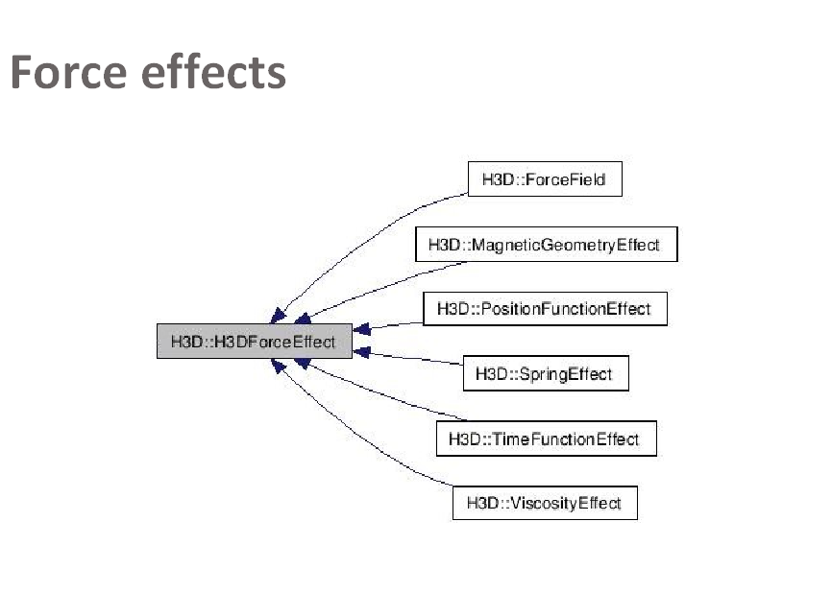

Slide 6
X3D example
<ForceField force=”1 0 0” />

Slide 7
Geometry haptic properties
Specified with the “surface” field in the Appearance node for the Shape.
<Shape>
<Appearance>
<Material/>
<SmoothSurface stiffness=“0.5” />
</Appearance>
<Cylinder radius=“0.005” height=“0.1”/>
</Shape>

Slide 8
Geometries
All geometries have the fields:
  isTouched (MFBool)
  force (MFVec3f)
  contactPoint (MFVec3f)
  contactNormal(MFVec3f)
  contactTexCoord(MFVec3f)
MF because possibility of several haptics devices.

Slide 9
Available surfaces
SmoothSurface
  No friction, only forces in the normal direction.
FrictionalSurface
  Friction and normal forces
DepthMapSurface
  Image specifies the depth at each point of geometry.
MagneticSurface(only OpenHapticsRenderer)
  Haptics device attracted to surface.
OpenHapticsSurface(only OpenHapticsRenderer)
  Special surface directly mapping to parameters of OpenHaptics. Can only be used with OpenHapticsRenderer.

Slide 10
Options
GraphicsCachingOptions
GeometryBoundOptions
HapticsOptions
DebugOptions
OpenHapticsOptions

Slide 11
Options
Local options
  Specified per geometry node
  <Sphere>
  <HapticsOptions maxDistance=”0.1” />
  </Sphere>
Global options(default values)
  GeneralSettings bindable node
  <GeneralSettings>
  <HapticsOptions maxDistance=”0.1” />
  </GeneralSettings>

Slide 12
GraphicsCachingOptions
useCaching
  use OpenGL display lists
cachingDelay
  the number of times to render after change before creating a display list
cacheOnlyGeometries
  Only use display lists for nodes inheriting from X3DGeometryNode.

Slide 13
GeometryBoundOptions
boundType (SPHERE, AABB, OBB)
  The type of bound to use for the the boundTree field in X3DGeometryNodes
maxTrianglesInLeaf
  The maximum number of triangles in a leaf of the boundTree.

Slide 14
HapticsOptions
touchableFace
  Specify which side of geometries that should be touchable
maxDistance
  Distance within which to render triangles haptically
lookAheadFactor
useBoundTree
  Use the boundTree field or OpenGL to find closest triangles.

Slide 15
Haptics
maxRadius
Proxy movement
LookAheadFactor * proxy movement

Slide 16
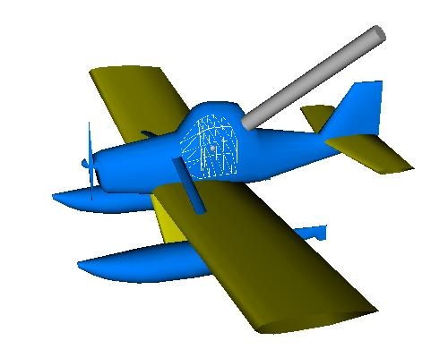

Slide 17
Haptic renderer nodes
Internal:
  GodObjectRenderer
  RuspiniRenderer
External:
  OpenHapticsRenderer
  Chai3DRenderer

Slide 18
H3DLoad and H3DViewer
Settings via H3DLoadSettings program
H3DLoad – console
H3DViewer – window application
  Settings for changing different options on the fly.

Slide 19
Exercise 1
Write a simple X3D scene with a Sphere that follows the haptics device.

Slide 20
Practical Exercises
Go through X3D documentation to identify useful nodes and write a simple scene using some simple geometries
  Transform nodes
  Geometry: Sphere, IndexedFaceSet
  Appearances
  Adding haptics!
  Using the SpaceTraveller

Slide 21
Exercise 2

